Slide 1

Microsoft Bot Framework
https://docs.microsoft.com/en-us/azure/bot-service/?view=azure-bot-service-4.0

Slide 2
Content
Basic Prerequisites
Azure AD
Create an app
LUIS
Create an app
Declare entities and intents
Microsoft Bot Framework Configuration
Azure configuration
Bot basic configuration
Initial skeleton solution walkthrough
Bot Framework Emulator
Microsoft Bot Framework Features
Dialogs
Prompts
Cards
Microsoft Bot Framework Data Storage
Microsoft Bot Framework Deployment
Microsoft Bot Framework Pricing and Alternatives

Slide 3
Basic Prerequisites
Azure Ad v2 App
LUIS app for language understanding
Web bot in azure panel

Slide 4
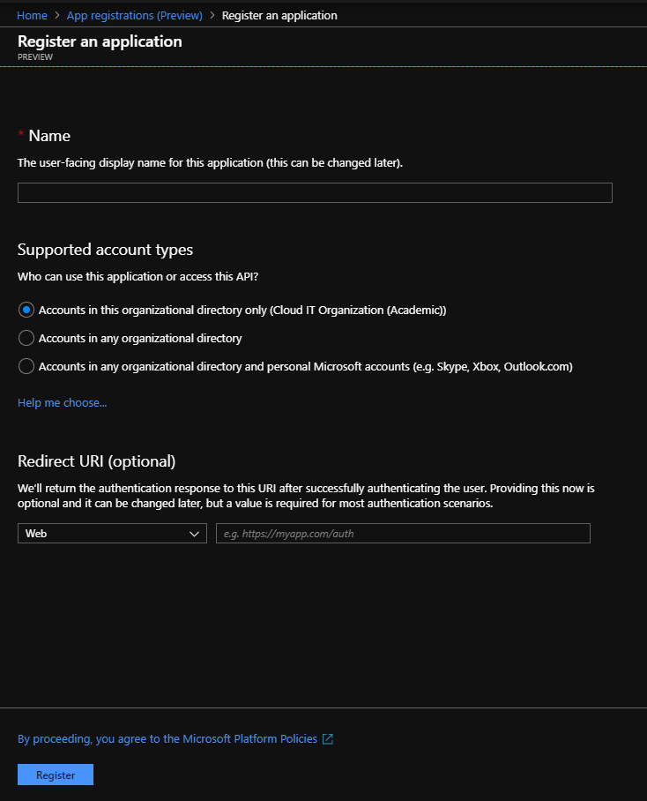
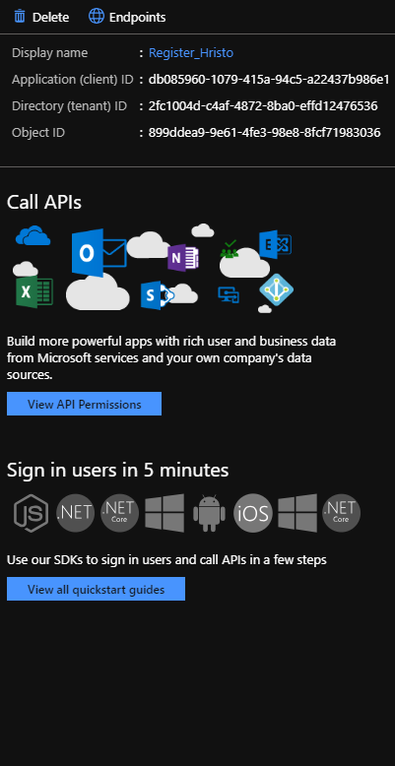
Azure Ad
To create a new app in Azure AD you must visit this link: https://portal.azure.com/#blade/Microsoft_AAD_RegisteredApps/ApplicationsListBlade
Choose a name and click register
Now we can see some important information for the app that we’ll use later

Slide 5
LUIS
LUIS – Language Understanding Intelligent Service
It is responsible for handling text and deciphering it’s meaning, extract the intents and it’s corresponding entities
It doesn’t work with Bulgarian yet though it is vastly requested – if you want to use it in Bulgarian you should use a translation API like Microsoft Translator API
Visit https://eu.luis.ai/applications and create a new application
Now you can create entities and intents

Slide 6
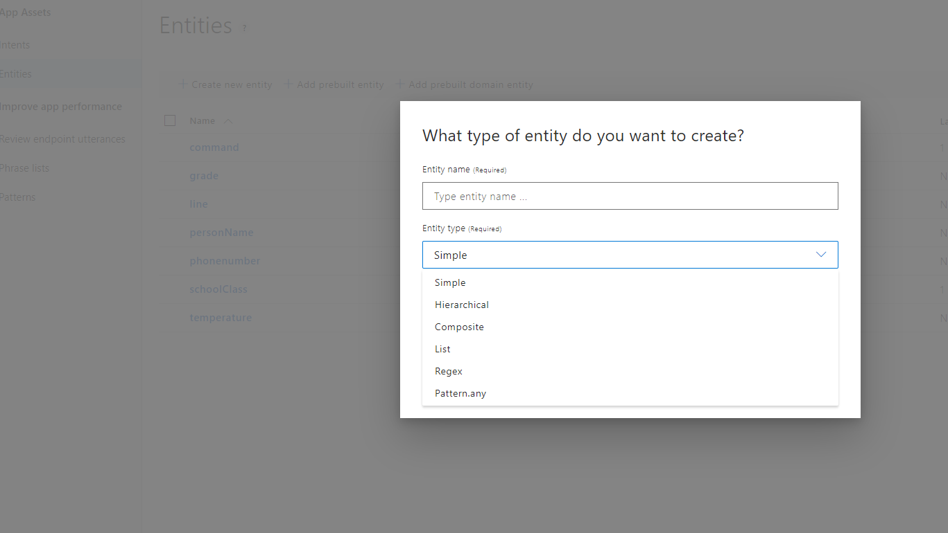
Luis entities
There are two types of entities – prebuilt(personName, address, etc.) and custom(the ones defined by you)
You can create a new entity which suits your needs – such as grade, course, etc.
There are several entity types which are well explained in the site

Slide 7
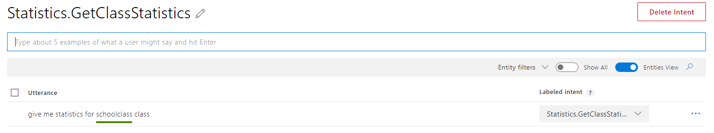
Intents
Intents are what LUIS recognizes from a message – it shall navigate the bot to the correct scenario it should follow
You can create and intent and the go play with it
You can type example sentences which should identify with this intent
Once you’ve got a typed sentence you may show which parts of the sentence should be extracted entities

Slide 8
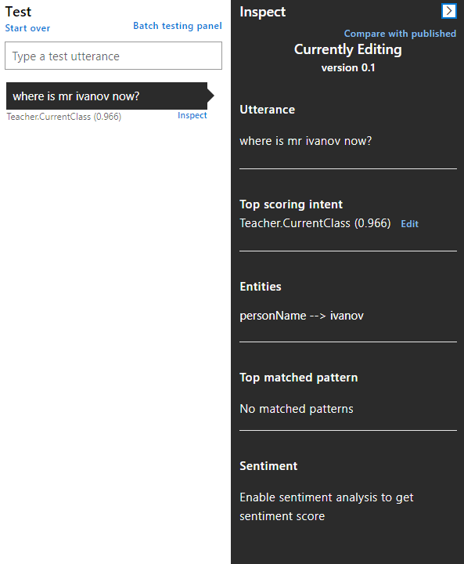
Training and testing
Once you’ve setup your intents and entities you may now train the LUIS model(by clicking train in the buttons section on the top right) and then test the model(the button next to train)

Slide 9
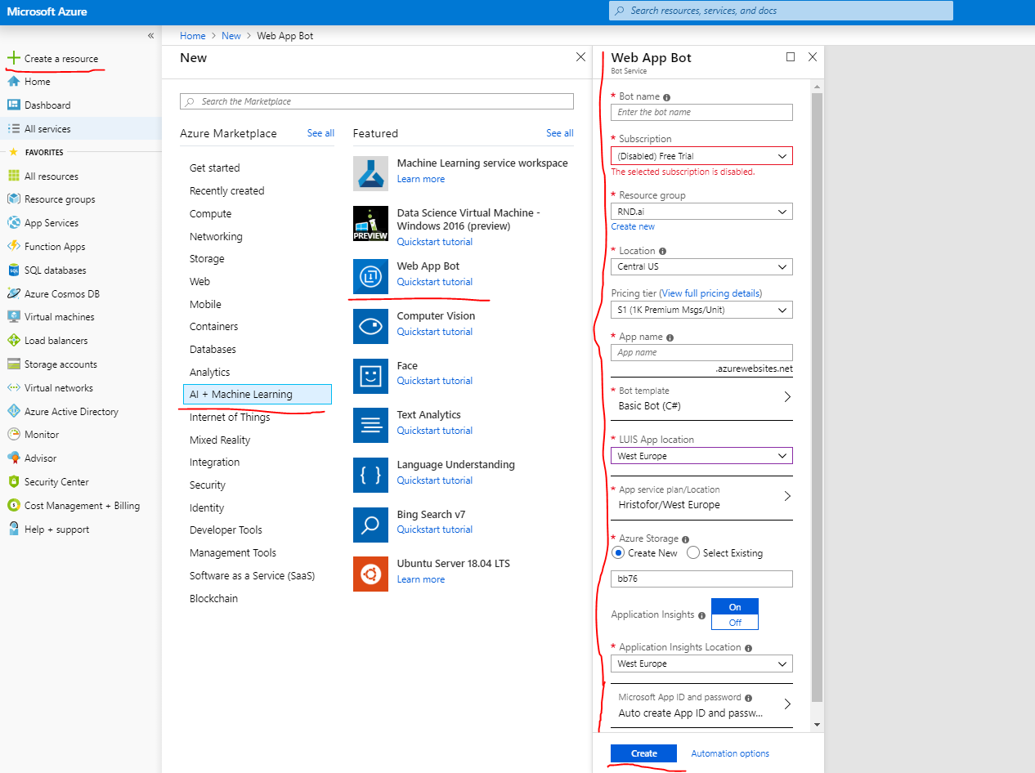
Microsoft Bot Framework Azure Configuration
To create a bot you need to go back to the Azure Panel and do the following steps
Once the bot is created go to the bot resource, choose Settings and choose Add Setting on the bottom of the page
This links the bot to the Azure AD app – choose a name for the setting and choose “Azure Active Directory v2” as service provider
Type in the required app properties and use “Mail.Read Mail.Send openid profile User.Read User.ReadBasic.All” for Scopes

Slide 10
Microsoft Bot Framework Basic Configuration
Once you’ve setup all these resources you should now open the Initial Skeleton Solution
There are two configuration files which you should configure
appsetting.json – bot file path and auth path settings
SampleBot.bot – refer to appsettings.values.txt to find out where to get each value

Slide 11
Initial Skeleton Walkthrough
Folder structure
Dialogs – pretty self-explanatory
Infrastructure – miscellaneous files such as extension methods, custom exceptions and constants
Models
NLP – utility models used for easy declaration of intents and entities to be parsed, customize if you see fit
Services
State – utility files that help control the memory state in the app

Slide 12
Basicbot.cs
BasicBot.cs is the main controller of out chatbot –
It’s got the following methods:
OnTurnAsync – that’s where messages are received and the respective dialogs are called
DeclareIntents – used to initialize the list of intents supported by your chatbot
ParseEntities – responsible for extracting entities for a specific intent from the received message command

Slide 13
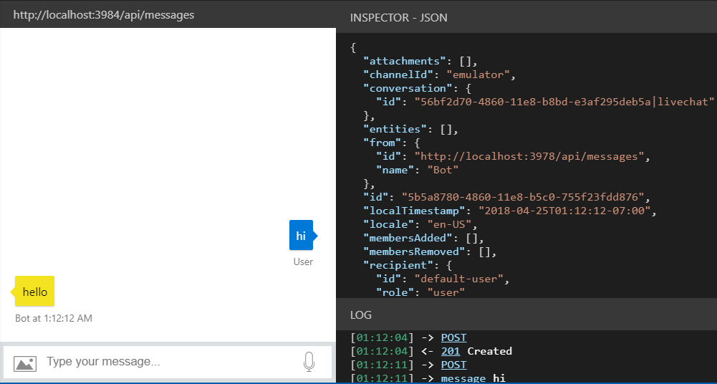
Microsoft Bot Framework Emulator
Bot Framework Emulator is a desktop software used to test bots in the development
Download Bot Framework Emulator and install it(optional: install and configure ngrok as well) - https://docs.microsoft.com/en-us/azure/bot-service/bot-service-debug-emulator?view=azure-bot-service-4.0
Open it and click Open Bot
Navigate to your bot file and open it(a bot secret may be required)
Test your bot using the emulator

Slide 14
Microsoft bot Framework Features
Dialogs, Prompts and cards

Slide 15
Dialogs
Chatbot conversations are meant to work this way:
User sends a message
The bot uses LUIS to comprehend the correct intent
A dialog is started based on the respective intent
A dialog consists of different steps in which the chatbot interacts with the user
Read more: https://docs.microsoft.com/en-us/azure/bot-service/bot-builder-concept-dialog?view=azure-bot-service-4.0

Slide 16
Dialog (Code Example)
public GreetingDialog(IStatePropertyAccessor<GreetingState> userProfileStateAccessor, ILoggerFactory loggerFactory)
: base(nameof(GreetingDialog))
{
UserProfileAccessor = userProfileStateAccessor ?? throw new ArgumentNullException(nameof(userProfileStateAccessor));
// Add control flow dialogs
var waterfallSteps = new WaterfallStep[]
{
InitializeStateStepAsync,
PromptForNameStepAsync,
PromptForCityStepAsync,
DisplayGreetingStateStepAsync,
};
AddDialog(new WaterfallDialog(ProfileDialog, waterfallSteps));
AddDialog(new TextPrompt(NamePrompt, ValidateName));
AddDialog(new TextPrompt(CityPrompt, ValidateCity));
}

Slide 17
Prompts
Prompts are a type of dialogs where the chatbot asks the user for some sort of input
There are different types of prompt
Attachment prompt
Choice prompt
Confirm prompt
Date-time prompt
Number prompt
Text prompt
Each prompt can have an additional validation method attached to it
Read more: https://docs.microsoft.com/en-us/azure/bot-service/bot-builder-concept-dialog?view=azure-bot-service-4.0#prompts

Slide 18
Prompt (Code Example)
return await stepContext.PromptAsync(
TooManyTeachersFoundPromptName,
new PromptOptions
{
Prompt = MessageFactory.Text(MessageConstants.TooManyTeachersFound),
RetryPrompt = MessageFactory.Text(MessageConstants.InvalidChoice),
Choices = ChoiceFactory.ToChoices(teachers.Select(t => t.Name).ToList()),
},
cancellationToken);

Slide 19
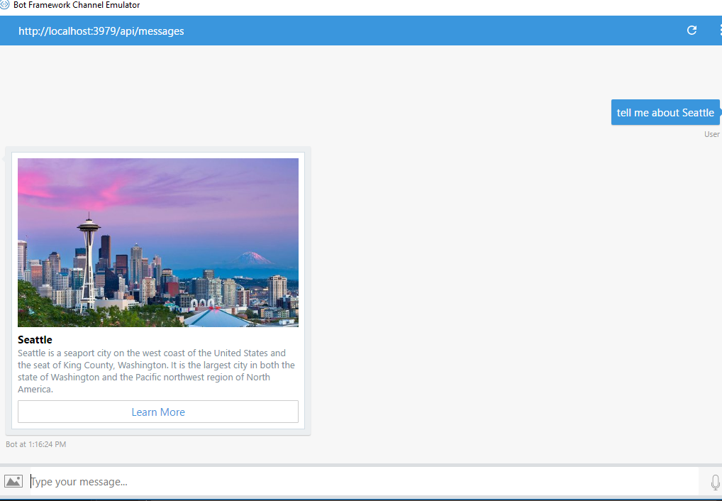
Cards
Chatbots can respond to users by using text or cards. Cards are a way to show content in a more structured style. They can include texts of different level(Title, label, content), images, buttons and links.
There are several types of cards
Adaptive cards
Animation cards
Audio cards
Hero cards
Thumbnail cards
Receipt cards
SignIn cards
Video Cards
Read more: https://docs.microsoft.com/en-us/azure/bot-service/dotnet/bot-builder-dotnet-add-rich-card-attachments?view=azure-bot-service-3.0

Slide 20
Card (Code Example)
var heroCard = new HeroCard
{
Title = teacherClass.TeacherName,
Subtitle = teacherClass.ToString(),
Text = teacherClass.Topic,
Buttons = new List<CardAction>
{
new CardAction(ActionTypes.OpenUrl, "Learn More", value: "http://www.devenvexe.com"),
new CardAction(ActionTypes.OpenUrl, "C# Corner", value: "http://www.c-sharpcorner.com/members/suthahar-j"),
new CardAction(ActionTypes.OpenUrl, "MSDN", value: "https://social.msdn.microsoft.com/profile/j%20suthahar/"),
},
};
return heroCard.ToAttachment();

Slide 21
Microsoft Bot Framework Storage
We often need to keep conversation or/and user data in order to make our chatbot more efficient after every use. That’s why we need a way to store all this data. As of March 2019 there are three ways to preserve data:
Memory storage – IMPORTANT NOTICE: Used for development and testing only. Not recommended for production uses
Using Cosmos DB
Using Blob storage
Using Blob Transcript
Memory storage is currently implemented in the Initial Skeleton Solution
As these options are often subject to change please refer to the following link: https://docs.microsoft.com/en-us/azure/bot-service/bot-builder-howto-v4-storage?view=azure-bot-service-4.0&tabs=csharp

Slide 22
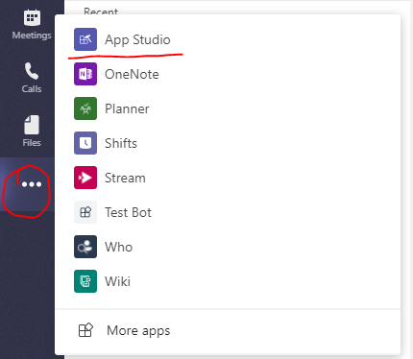
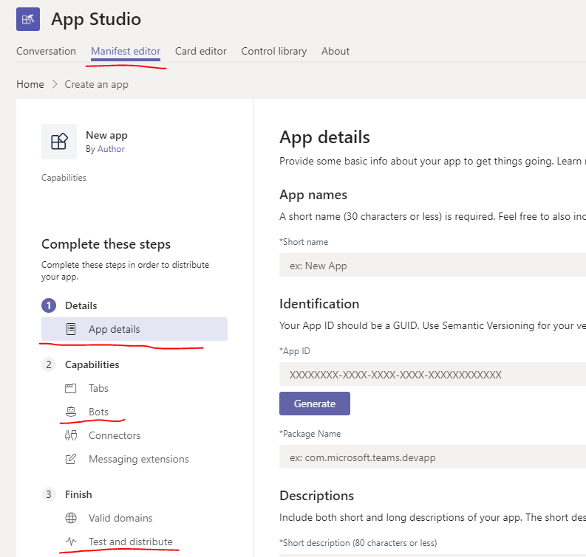
Microsoft bot Framework Deployment
You can find info on how to deploy your bot to here: https://docs.microsoft.com/en-us/azure/bot-service/bot-builder-deploy-az-cli?view=azure-bot-service-4.0&tabs=csharp
To use your bot in Microsoft Teams use the Teams App Studio(shown on the images)

Slide 23
Microsoft Bot Framework Pricing
Azure Web Bot | LUIS | Cosmos DB | MS Translator API
$0.50 per 1000 messages | $1.50 per 1000 transactions | $6/month for 100 RU/s | $10 per million chars of standard translation

Slide 24
Microsoft Bot Framework Alternatives
Tool | Target Platforms | Top examples | Bulgarian Support | Cool features | Pricing
MS Bot Framework | Website, App, Cortana, Microsoft Teams, Skype, Slack, Facebook Messenger | UPS | No | Can have custom NLP and storage if paid for | See previous slide
IBM Watson | Facebook Messenger, WhatsApp, Instagram | Staples, H&R Block, Autodesk | No | Has custom NLP | $0.0025 per API call
Wit.ai | Website, App, Cortana, Microsoft Teams, Skype, Slack, Facebook Messenger | UPS | Yes | Has custom NLP | $0.50 per 1,000 messages
Semantic Machines | Website, App, Cortana, Microsoft Teams, Skype, Slack, Facebook Messenger | UPS | Language Independent | Has custom NLP | N/A
Reply.ai | Cortana, Microsoft Teams, Skype, Slack, Facebook Messenger | Samsung, Coca-Cola, KIA, Hilton, Ad Council | No | Has custom NLP | N/A
Telerik KinveyChat | Facebook, Viber, iOS, Android, Websites | N/A | Yes | Has custom NLP and storage | $4,995/month

Slide 25

You can now go destroy the world!

